Slide 1

History of the internet
Jarne Everaerts

Slide 2
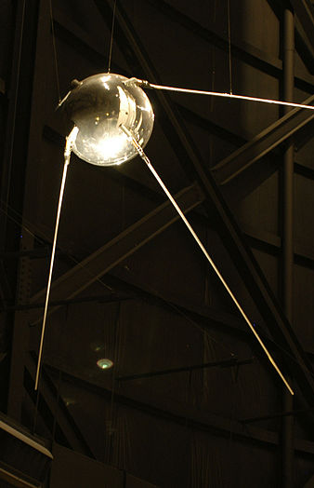
How did it all start
Cold war
Sputnik 1
ARPA
Notes:
4 October 1957 Advanced Research Projects Agency

Slide 3
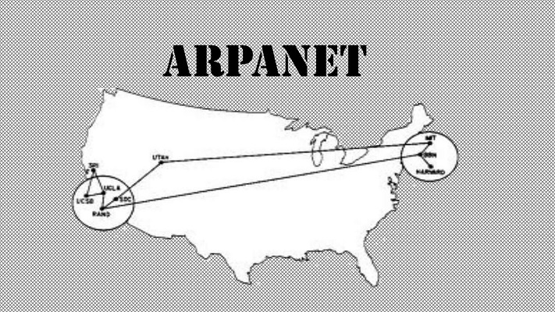
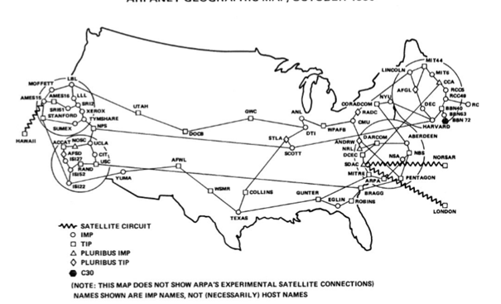
ARPANET
Packet-Switching
Military use
Notes:
Packet-switching: data into packet header = destination payload = data
---\ /--- --- > < --- ---/ \--- interface message processor

Slide 4
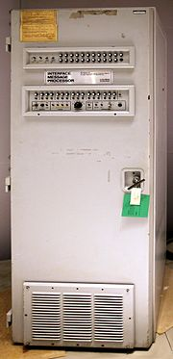
Don’t shoot the IMP
Notes:
Interface Message Processor messenger store forward 1 University of California Los Angeles 2 Stanford Research Institute 3 University of California Santa Barbara
4 University of Utah test login crash on g 1 in 20K tests succeeded

Slide 5
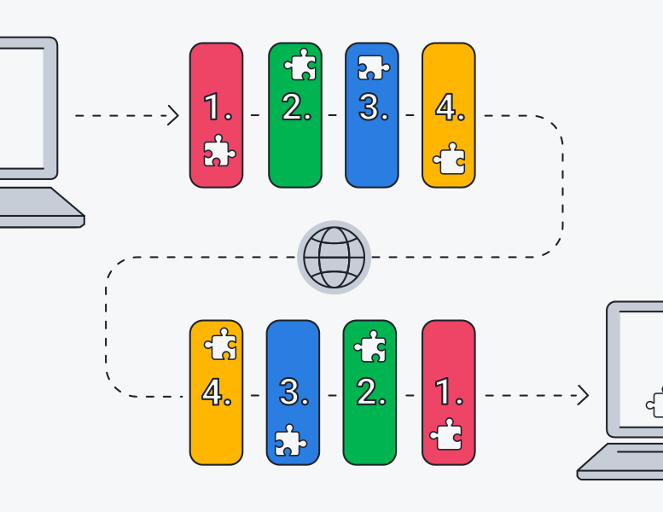
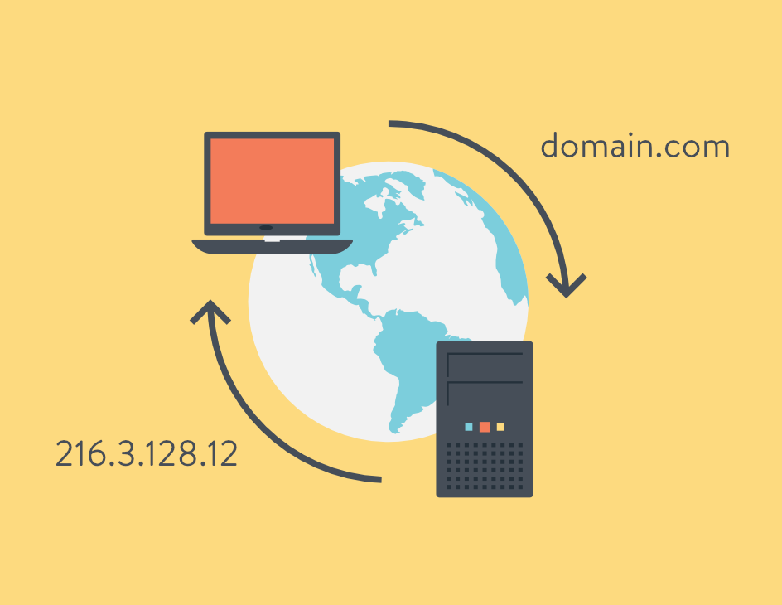
Communication is the Key
Email
TCP/IP
DNS
Notes:
1971 eerste email @ to identify users on arpa Transmission Control Protocol/Internet Protocol

Slide 6


Dial up

Slide 7

The start of something new

Slide 8
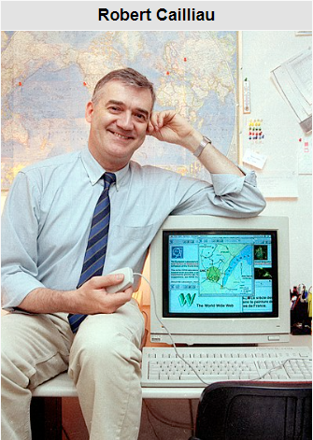
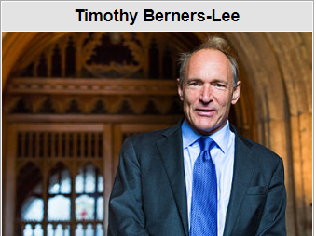
World Wide Web

Slide 9

Mobile Broadband

Slide 10
Be gentle its my first time

Slide 11


Let's lose these cords

Slide 12
Work hard Play harder

Slide 13


